Slide 1
CSS and Making the App Look Professional

Slide 2
Learning goals
We will learn CSS, layout, responsive design, and how React connects components to styles.
The important point is that React controls what the app does; CSS controls what it looks like.

Slide 3


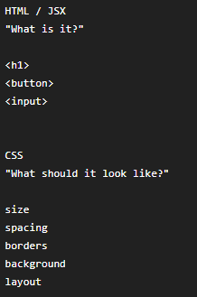
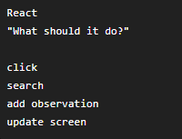
What is CSS
We currently write JSX like:
CSS lets us say things like:
Think of the responsibilities this way:
React adds another responsibility:

Slide 4
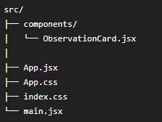

Find App.css
Your project should already contain:
Open App.css
Remove template code.
Then at the top of App.jsx, make sure you import App.css:
Now CSS in App.css can style our application.

Slide 5

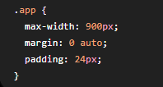
Give the app a container
Change the top-level div in App.jsx from:
to:
Now put this in App.css:
Run “npm run dev” command. Your content should now to be constrained and centered.

Slide 6


Understanding className
CSS classes let us identify groups of elements.
For example,
and CSS:
The . means:
  Apply this style to anything whose class is observation-card.

Slide 7
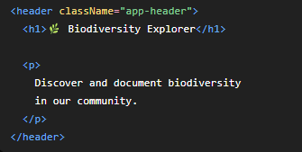
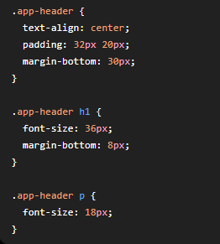
Create a header
In App.jsx, replace the simple heading with
Now add:
Style h1elements that are inside .app-header

Slide 8

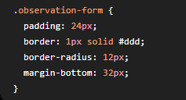
Style our form (card-like form)
Wrap the form like this
Then add

Slide 9

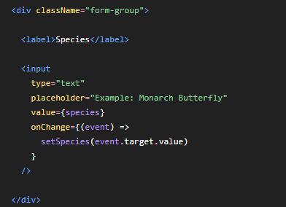
Add labels
Forms should have labels rather than relying only on placeholders.
Instead of
Use:
Do the same for location and other fields.

Slide 10
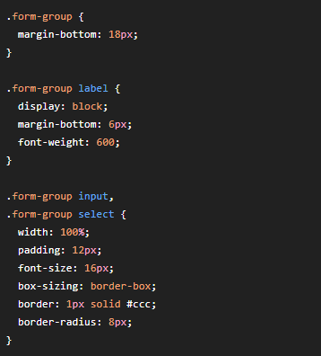
Style form groups
In App.css, add:

Slide 11
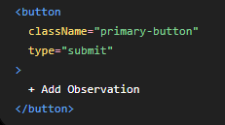
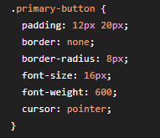

Style the Add Observation button
Give it a class:
CSS:
Then:
:hover means:
  Apply this style when the mouse is over the element.

Slide 12
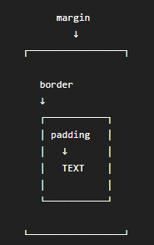


What is padding versus margin?
Imagin a box: Padding = space inside an element.
Margin = space outside an element.
Gives the contents breathing room inside the card.
Creates space between this card and whatever comes next.

Slide 13

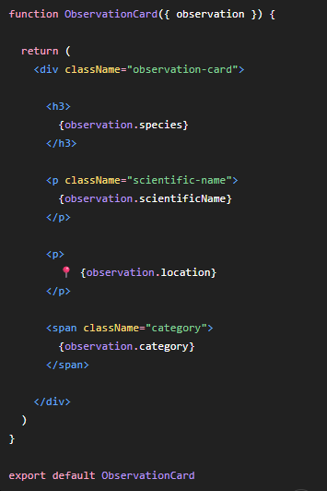
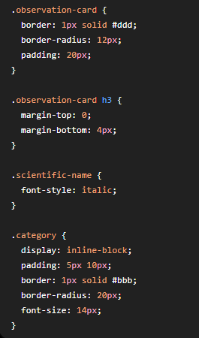
Style observation cards
Open:
Change it to: Then add to App.css

Slide 14
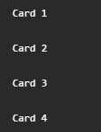
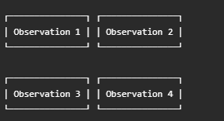
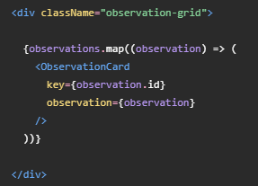
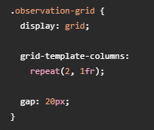
Use CSS Grid
Right now your observations probably appear:
On a computer screen, we’d rather have:
Wrap the cards:
Then add this to App.css:
Make two equal-width column

Slide 15

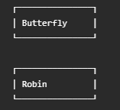
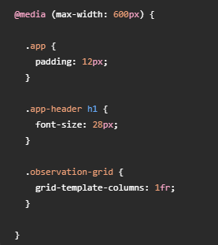
Make it work on phones
We want computer display:
Display on phone:
Css can automatically detect a smaller screen.
Add this to App.css:
This is called a media query.
It says:
  When the screen is 600 pixels
  Wide or less, use this styles

Slide 16

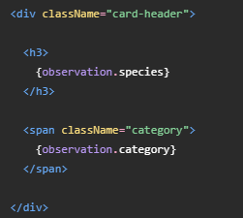
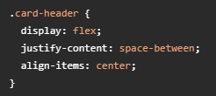
One more useful CSS technique: Flexbox
Suppose later we want:
We can write in ObservationCards.jsx:
Then add this to App.css:
Puts the elements into a flexible layout.
Pushes them apart

Slide 17

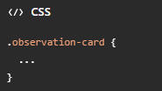
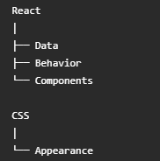
What you should understand after lesson 6
You don’t need to memorize every CSS property.
The important ideas are:
  className connects JSX elements to CSS:
  Padding and margin control spacing.
  Flexbox is useful for arranging things
  in rows/columns.
  Grid is excellent for arranging cards.
  Media queries make the application responsive
  And most importantly:

